Slide 1

Auto-Wash
Automated Car Wash Center Management System
Software Requirements Specification (SRS) - Version 2.9
FPT University · SWR302

Slide 2




Background & Purpose
Problem
SRS Objective
Digitize automated car wash center operations - from customer bookings to on-site queue management.
Define business scope, align functional & non-functional requirements, and serve as the basis for User Acceptance Testing (UAT).
Product
Reference Standard
Web application - Customers use Mobile Web, Staff use Desktop.
Complies with the IEEE 830-1998 SRS documentation standard.

Slide 3





Technology Architecture
Frontend
React 18 + Vite - SPA, optimized for mobile
Backend
ASP.NET Core 8 · Entity Framework Core (Npgsql)
Database
PostgreSQL via Supabase - SSL required
Communication
JSON REST API
Session
Server-side session - stateless, load-balancing ready

Slide 4



Actors & External Systems
Staff
Customer
System
Vehicle check-in / check-out
Scan license plate, manage queue
Confirm / cancel bookings
Manage accounts & services
Register, manage personal vehicles
Create & track bookings (Mobile Web)
Receive email notifications
Automatically send OTP / confirmation / completion emails
Receive license plate recognition (LPR) results
External Systems
Email SMTP (Gmail / MailKit) · Camera LPR · 3rd-party LPR API

Slide 5
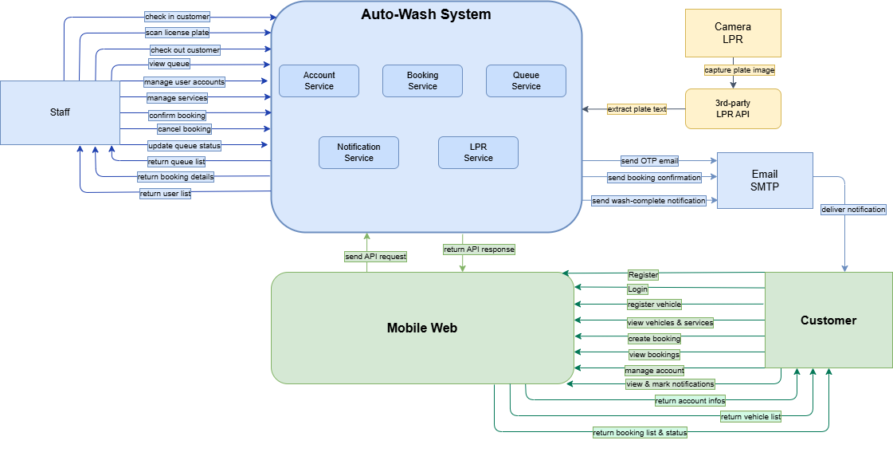
Context Diagram

Slide 6
ERD - 9 Entities
Entity | Role
Account | Identity, email/phone, PasswordHash, Role (1=Staff, 2=Customer)
Customer | Customer profile + statistics (TotalVisits, TotalSpend)
Vehicle | Customer's vehicle - normalized LicensePlate
Booking | Booking (ScheduledAt, Status 1–5, price)
BookingService | Junction table Booking ↔ Service (PriceSnapshot)
Service | Service catalog (Category 1–4, price, duration)
Queue | On-site queue (Position, timestamps)
Notification | In-app notification
OtpVerification | Temporary OTP code (no foreign key)

Slide 7
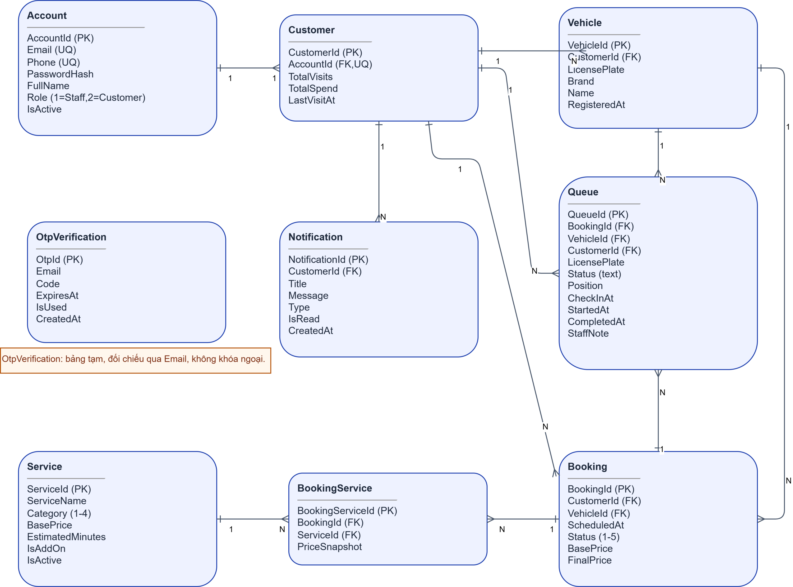
ERD- 9 Entities

Slide 8
5 Functional Modules - 24 Use Cases
Module | Use Case
General | UC1 Login · UC2 Logout
Account Management | UC3 Register · UC4 Update profile · UC5 Change password · UC6 Manage user accounts
Vehicle Management | UC7 View vehicles · UC8 Register vehicle · UC9 Delete vehicle
Services & Booking | UC10 View services · UC11 Manage services · UC12 Create booking · UC13 View bookings · UC14 Confirm · UC15 Cancel
Queue | UC16–UC22 · Check-in, LPR, status transition, update, check-out, cancel turn
Notifications | UC23 View · UC24 Mark as read

Slide 9
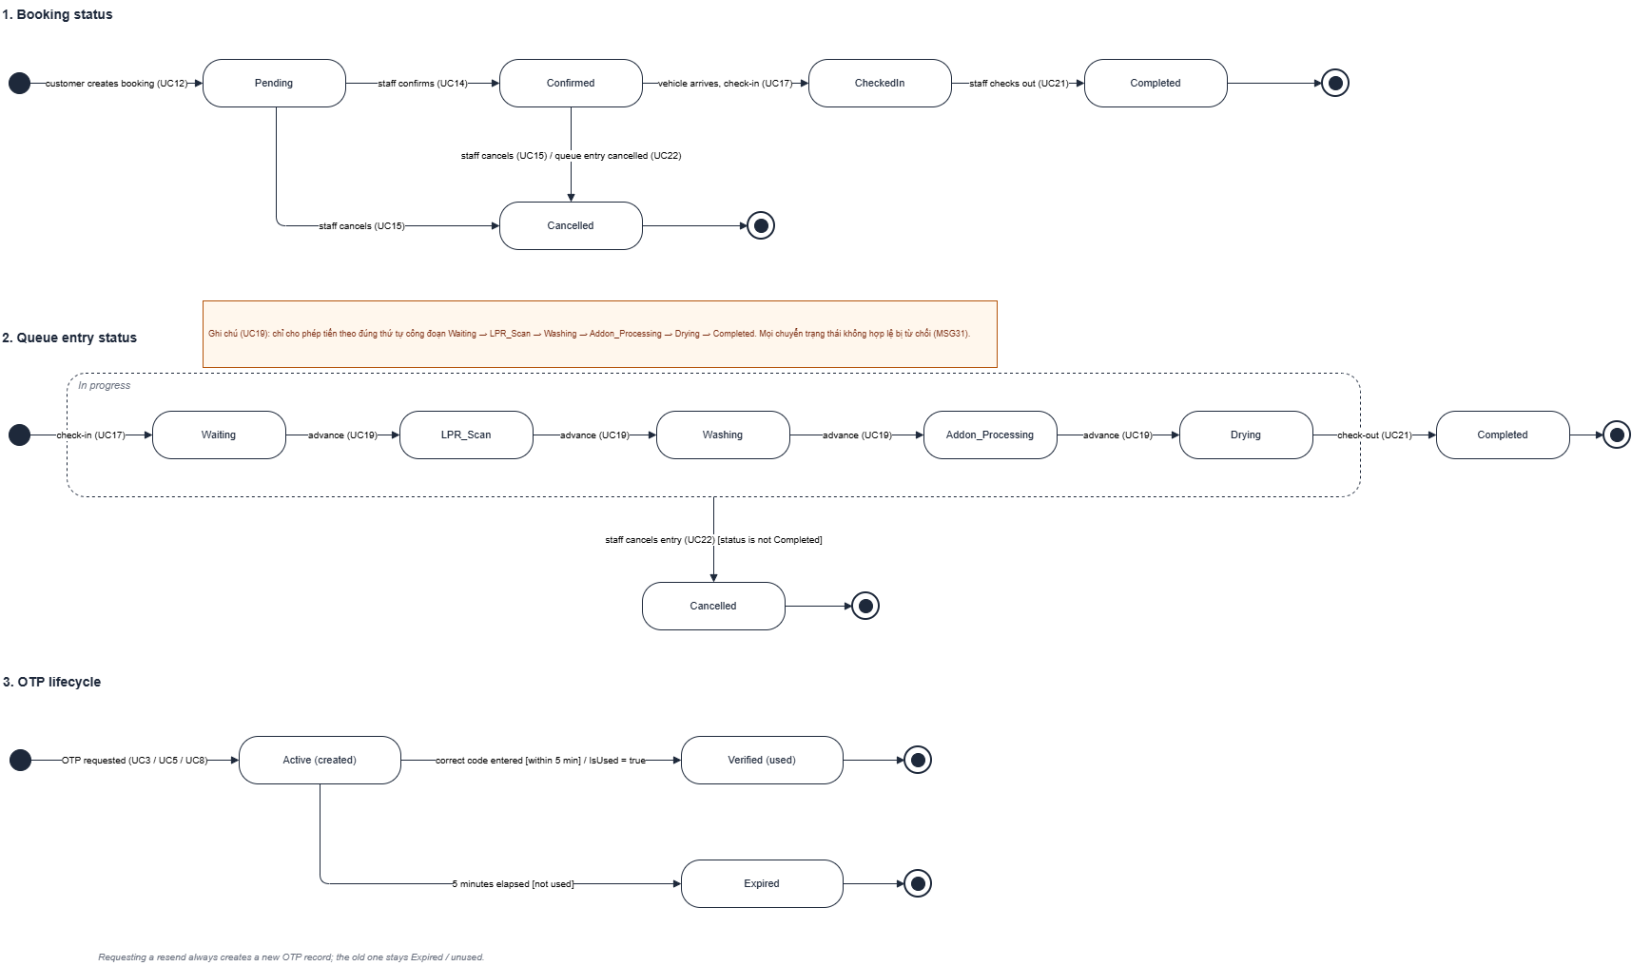
State transition diagrama

Slide 10
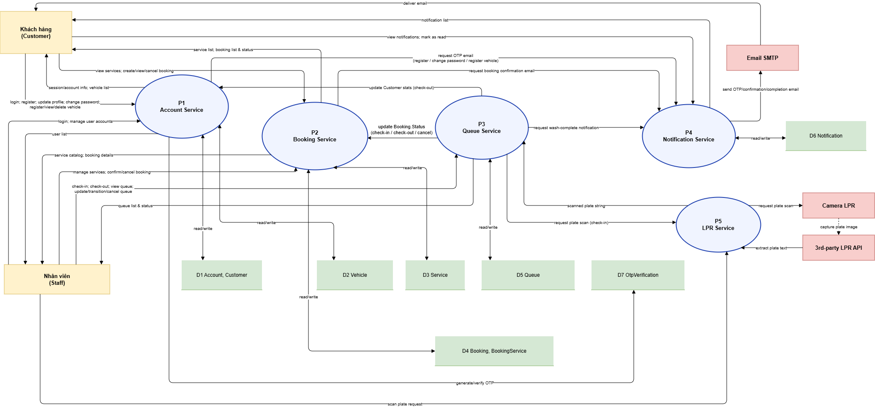
Data flow diagrama

Slide 11
Non-Functional Requirements (NFR)
Performance
API response < 2s (P95) · Booking creation < 3s · OTP email < 60s · LPR result < 5s · 50 concurrent sessions
Security
Bcrypt password hashing · Server-side sessions (401/403) · OTP hashed, single-use, 5-min expiry · Secrets in env vars · HTTPS enforced
Usability
Responsive: Mobile Web ≥375px, Staff desktop ≥1024px · Clear error messages (MSG1–25) · Loading indicators · Booking confirmation summary
Availability & Reliability
Uptime ≥ 99% (07:00–22:00 ICT) · Maintenance off-hours only · Transactional DB writes · Manual LPR fallback
Scalability
Supabase PostgreSQL, horizontally scalable · Stateless backend, load-balancing ready · Single-branch scope; multi-branch out of scope

Slide 12
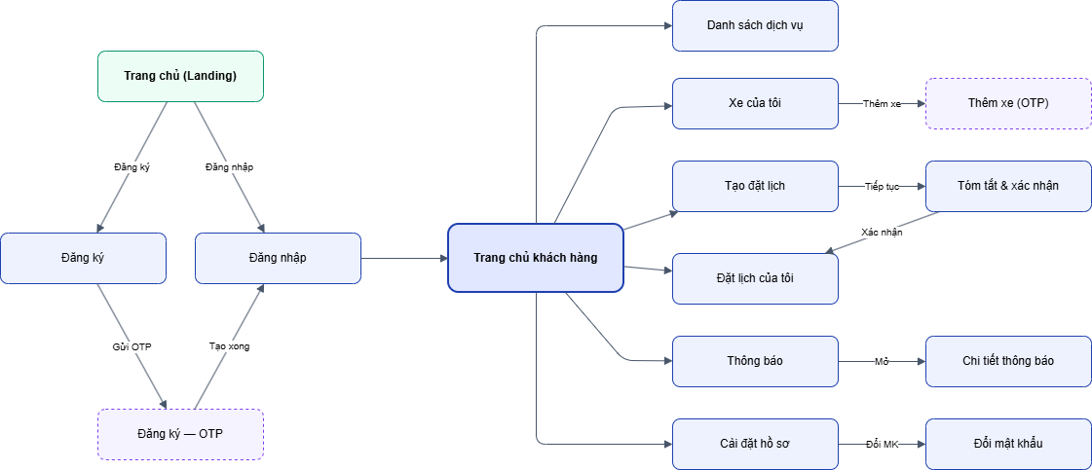
Dialog Diagram

Slide 13
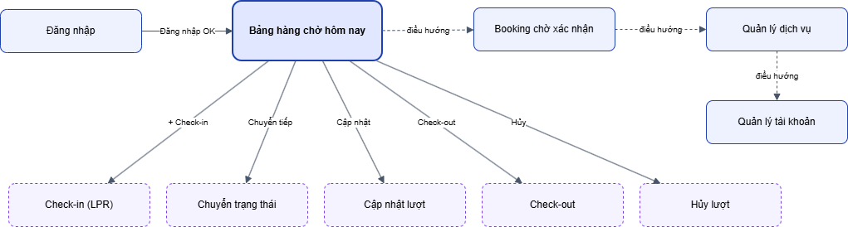
Dialog Diagram

Slide 14
Thank You
Questions & Answers (Q&A)

